Slide 1


Need of React
M ARAVIND
22H51A0539

Slide 2

What is React?
React is a JavaScript library used for building user interfaces, primarily for single-page applications. It's known for its component-based architecture, which breaks down UI into reusable pieces, making development more modular and maintainable.
Component-Based
Declarative
React applications are built using components, which are independent and reusable blocks of code representing a part of the UI.
React focuses on describing what the UI should look like, rather than how to update it, simplifying UI development and making it more predictable.
Virtual DOM
React utilizes a virtual DOM, a lightweight representation of the actual DOM, for efficient updates. Changes are calculated in the virtual DOM before being applied to the actual DOM.

Slide 3
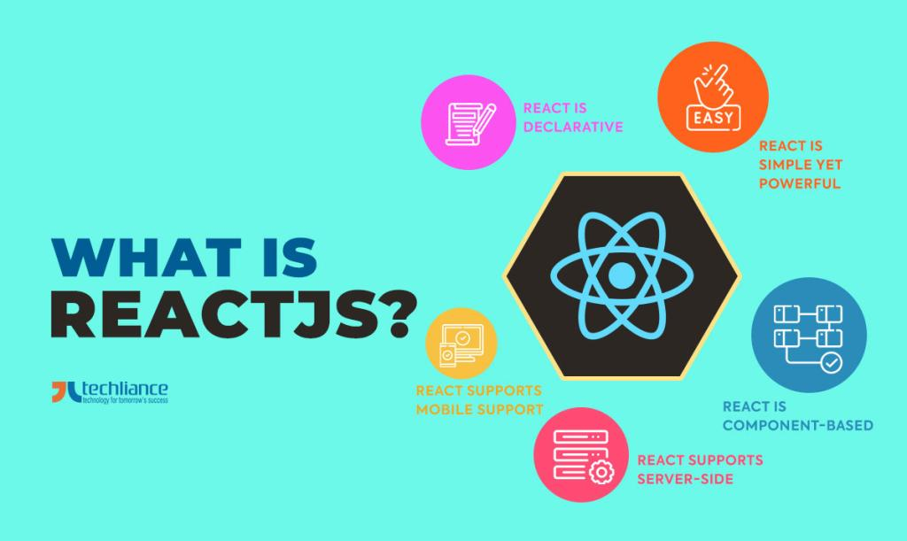
Why use React?
React offers several advantages that make it a popular choice for building web applications.
1
Performance
2
Reusability
React's virtual DOM and efficient update mechanism contribute to a smooth and responsive user experience.
Components can be reused across different parts of the application, reducing code duplication and speeding up development.
3
Community
4
Scalability
React boasts a large and active community, providing ample support, resources, and pre-built components for faster development.
React's component-based architecture makes it easy to scale applications as they grow in complexity.

Slide 4
Key features of React
React offers a variety of features that empower developers to create modern and dynamic user interfaces.
JSX
Virtual DOM
Components
JSX allows you to write HTML-like syntax directly within your JavaScript code, making UI development more intuitive and visually appealing.
The virtual DOM is a lightweight representation of the actual DOM, which allows React to efficiently calculate and apply updates, resulting in improved performance.
Components are the building blocks of React applications, allowing you to break down UI into reusable pieces, making development more modular and maintainable.

Slide 5
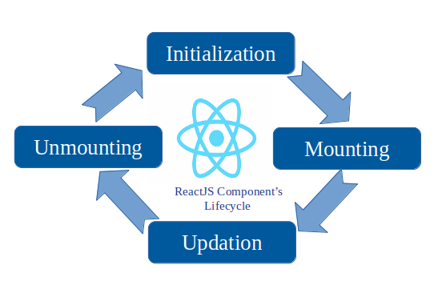
React components and their lifecycle
React components are the fundamental building blocks of React applications, and they have a defined lifecycle that governs their behavior from creation to destruction.
1
Initialization
The component is created and its initial state is set.
2
Rendering
The component is rendered to the DOM.
3
Updating
The component receives new props or state, triggering a re-rendering process.
4
Un-Mounting
The component is removed from the DOM.

Slide 6
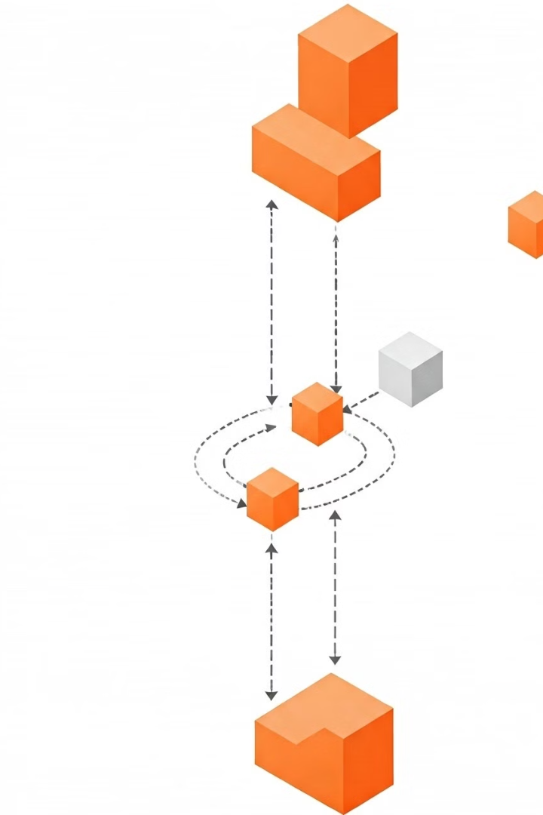

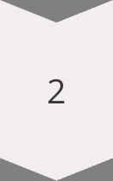
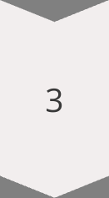
State management in React
State management is a crucial aspect of React applications, as it enables components to hold and update their own data, making them dynamic and responsive to user interactions.
Component State
Each component can maintain its own state, which is an object representing the component's current data.
State Updates
Components can update their state using the `setState()` method, which triggers a re-rendering of the component and its children.
State Management Libraries
For larger applications, state management libraries like Redux or MobX can be used to centralize state management and improve application scalability.

Slide 7
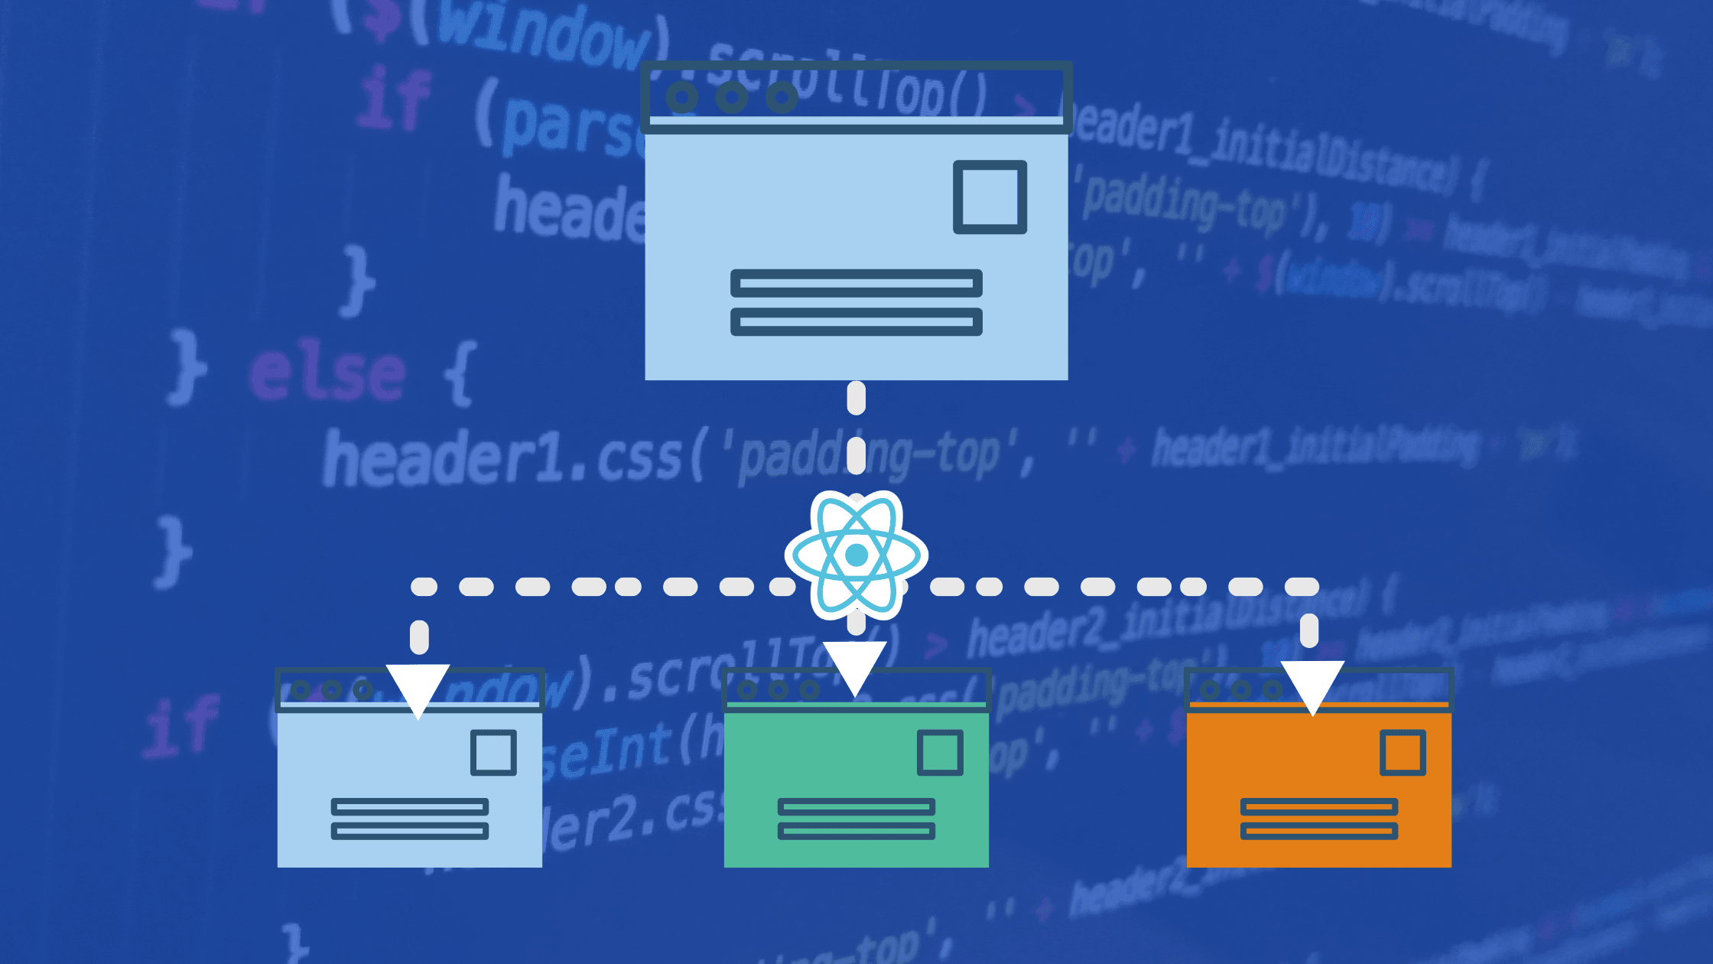
React Routing and Navigation
Routing in React enables navigation between different views or pages within an application, providing a seamless user experience.
React Router
A popular library that provides a declarative way to manage routing in React applications.
Routes
Define the different routes or URLs within your application and map them to specific components.
Navigation
Allow users to move between different routes by clicking on links, buttons, or using browser history.

Slide 8


Conclusion and summary
React is a powerful and versatile library for building modern web applications, offering a robust set of features and a thriving community.
High Performance
Component Reusability
Strong Community
Scalable Architecture
React's Virtual DOM and efficient updates contribute to a smooth user experience.
React components are reusable across the application, reducing code duplication and speeding up development.
A large and active community provides ample support, resources, and pre-built components.
The component-based architecture makes it easy to scale applications as they grow in complexity.

Slide 9
THANK YOU

